Slide 1
Using Telehealth for Behavioral Health in Pediatric Primary Care: Adapting to COVID-19
August 20, 2020

Slide 2
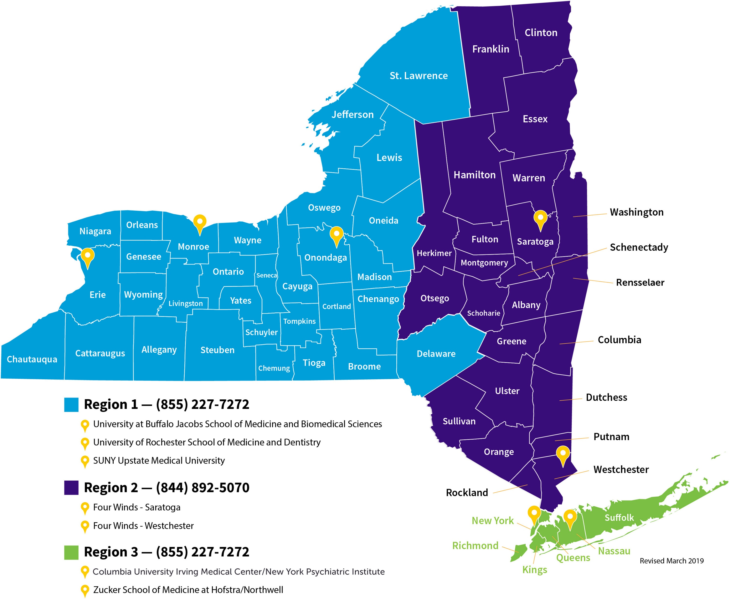
Project TEACH Regional Providers

Slide 3


Disclosures
None of the presenters have any disclosures.

Slide 4
Telemedicine in Primary care – Current Environment
Doc in the Box – no patient physician history
Variations
Telephone calls (historically not paid)
E-mails (HIPAA concerns)
Telemedicine Visits
Synchronous (secure platforms, Zoom, EMR embedded (not Facetime, Skype, etc)
Asynchronous (secure text messaging or emails – e.g. - pingMD)

Slide 5
Telemedicine in Primary care – Current Environment
Telemedicine in Primary Care – how to use it?
When do we need to lay on hands?
Can we be creative? (Amazon fiber optic otoscopes)

Slide 6
Telemedicine in Primary care - Benefits
Positive Aspects
Safety – no exposure
Access to care - flexibility
Convenience – travel time, wait time, childcare, flexibility
Virtual house call – can view home and family interactions

Slide 7
Telemedicine in Primary care – Regulations Change
Department of Financial Services adopts new emergency regulation requiring insurance companies to waive cost-sharing for in-network telehealth visits (https://dfs.ny.gov/reports_and_publications/press_releases/pr20203171)
Notification of Enforcement Discretion for telehealth remote communications during the COVID-19 nationwide public health emergency (https://www.hhs.gov/hipaa/for-professionals/special-topics/emergency-preparedness/notification-enforcement-discretion-telehealth/index.html)

Slide 8
Telemedicine in Primary care – Regulations Change
"Under this Notice, covered health care providers may use popular applications that allow for video chats, including Apple FaceTime, Facebook Messenger video chat, Google Hangouts video, or Skype, to provide telehealth without risk that OCR might seek to impose a penalty for noncompliance with the HIPAA Rules related to the good faith provision of telehealth during the COVID-19 nationwide public health emergency. Providers are encouraged to notify patients that these third-party applications potentially introduce privacy risks, and providers should enable all available encryption and privacy modes when using such applications."

Slide 9
Telemedicine in Primary care – Practical Aspects
Payment – if we keep patients out of the office, we lose income
Pre-pandemic, some (few) payors paid for visits but at reduced rates
Post March 13, coverage at 100% even for routine visits
Access to technology – will even cover phone calls as telemedicine visit

Slide 10
Telemedicine in Primary care - Coding
E&M codes
Modifiers -95 – Synchronous
GT – Asynchronous
GC – Phone call
Telephone call coding
99441-99443 Phone Evaluation/Mgt. Evaluation/Management
99371-99373 Phone Consultation

Slide 11
Telehealth for Behavioral Health: The Bronx Experience
Advantages
Access in a time of stress
Window into the family’s life
Frequent follow-up
Sending materials via email
Disadvantages
Lack of access for the poor or less educated populations
Non-English speakers
Privacy
Novelty and need to adhere to basic principles of assessment

Slide 12
Telehealth for Behavioral Health: The Bronx Experience
Lesson’s Learned
Schedule specific times for behavioral health televisits
Send out primary and secondary screening tools to the family before the visit
Send out materials after the visit, to reinforce plan
Document carefully to allow for accurate billing

Slide 13
Bigger Picture Advice: Don’t Panic
Remember Best Standards of Care and follow Evidence-Based Principles:
Interview the parent and patient
Advantage: Family members can be in different locations
Disadvantage: Moving one device into different rooms or having to log into more than one device
Interview the patient alone (some exceptions)
Advantage: Teens like screens
Disadvantage: Disruptive kids can mute you or turn off picture (have parent on standby)
Privacy needed for sensitive information
Advantage: Headphones can prevent everyone hearing the whole conversation
Disadvantage: Small spaces, thin walls. (May need to use the bathroom!)

Slide 14
Bigger Picture Advice: Don’t Panic
Remember Best Standards of Care and follow Evidence-Based Principles:
Use Rating Scales
Advantage: Can be completed in a less stressful environment
Disadvantage: More difficult to keep the parents from completing or viewing the child’s answers (perhaps email directly with the teen, complete with the teen on telehealth?). Harder to send in real time.

Slide 15
Smaller Picture Advice: Collected wisdom
Consider yourself the IT Team:
Spend time helping parents and family learn the technology.
Don’t get flustered or annoyed- It will help later
Don’t settle for less if it can be fixed (e.g. ask patients to move closer to a window, raise the volume, etc.)
Create workarounds (e.g. video on screen but audio on call)

Slide 16
Smaller Picture Advice: Collected wisdom
Remember your non-verbal communication:
If charting on a screen at the same time, use screens or windows that are above and below vs side to side so that you are nodding yes and not shaking your head no as the patient speaks
Interrupting with affirmative or empathic statements may be more difficult given the delays in transmission – be more responsive with facial and hand gestures (waving hello and good-bye, thumbs-up, nodding more forcefully, shaking your head at sad news, smiling wide when appropriate, etc.

Slide 17
Finally: Remember you are not actually alone (even if you are isolated) and there are other resources out there!
Some mobile crisis, emergency rooms, home-based crisis intervention, inpatient hospitals, partial hospitals, day treatment programs, and outpatient services may have changed their way of working (telehealth), may have limited their services, or may have shut down but others suited up and stayed functioning-- there is still a safety net out there for patients that need to be seen by more than a PCP telehealth visit.
Call us for advice if you don’t know what is available to help you.

Slide 18
Telemental Healthcare in Primary Care- Upstate
PRIMARY CARE PROVIDERS
Upstate PCPs can feel isolated in rural areas without adequate mental health services.
Compounded during Covid as the minimal available options suddenly dried up.
Project Teach was able to continue to provide consultations on difficult patients without significant delay through telemental health.
Full “virtual” psychiatric evaluations on patients often within days of the initial consultation
Able to provide appropriate and timely follow up and therapy referral options.

Slide 19
Telemental Healthcare in Primary Care- Upstate
PATIENTS
Telemental health was received initially as “better than nothing” but rapidly became “the new norm.”
Access to mental health rapidly improved. Catchment area expanded allowing us to see clients we’d usually have to refer on to other providers.
Extremely convenient for families worried about their health and wellbeing
Cut down on significant commutes from patients located in remote areas.
Telephonic or mixed-media devices improved access for patients with poor internet connections
Able to meet additional family members (and lots of pets)

Slide 20
Telemental Healthcare in Primary Care- Upstate
AREAS TO IMPROVE
Hard to replace the “in-person experience” for diagnostic interviews.
The camera does not translate subtle things well (gaze maintenance, etc.)
Technology seems “almost there” for secure and reliable videoconferencing.
Rural internet connections are spotty at times
Hope to continue with telemental health after pandemic due to the advantages

Slide 21


Thank You
Phyllis Kaufman, JD
Senior Project Manager, Project TEACH
pkaufman2@mgh.harvard.edu
info@projectteachny.org
projectteachny.org

